Slide 1

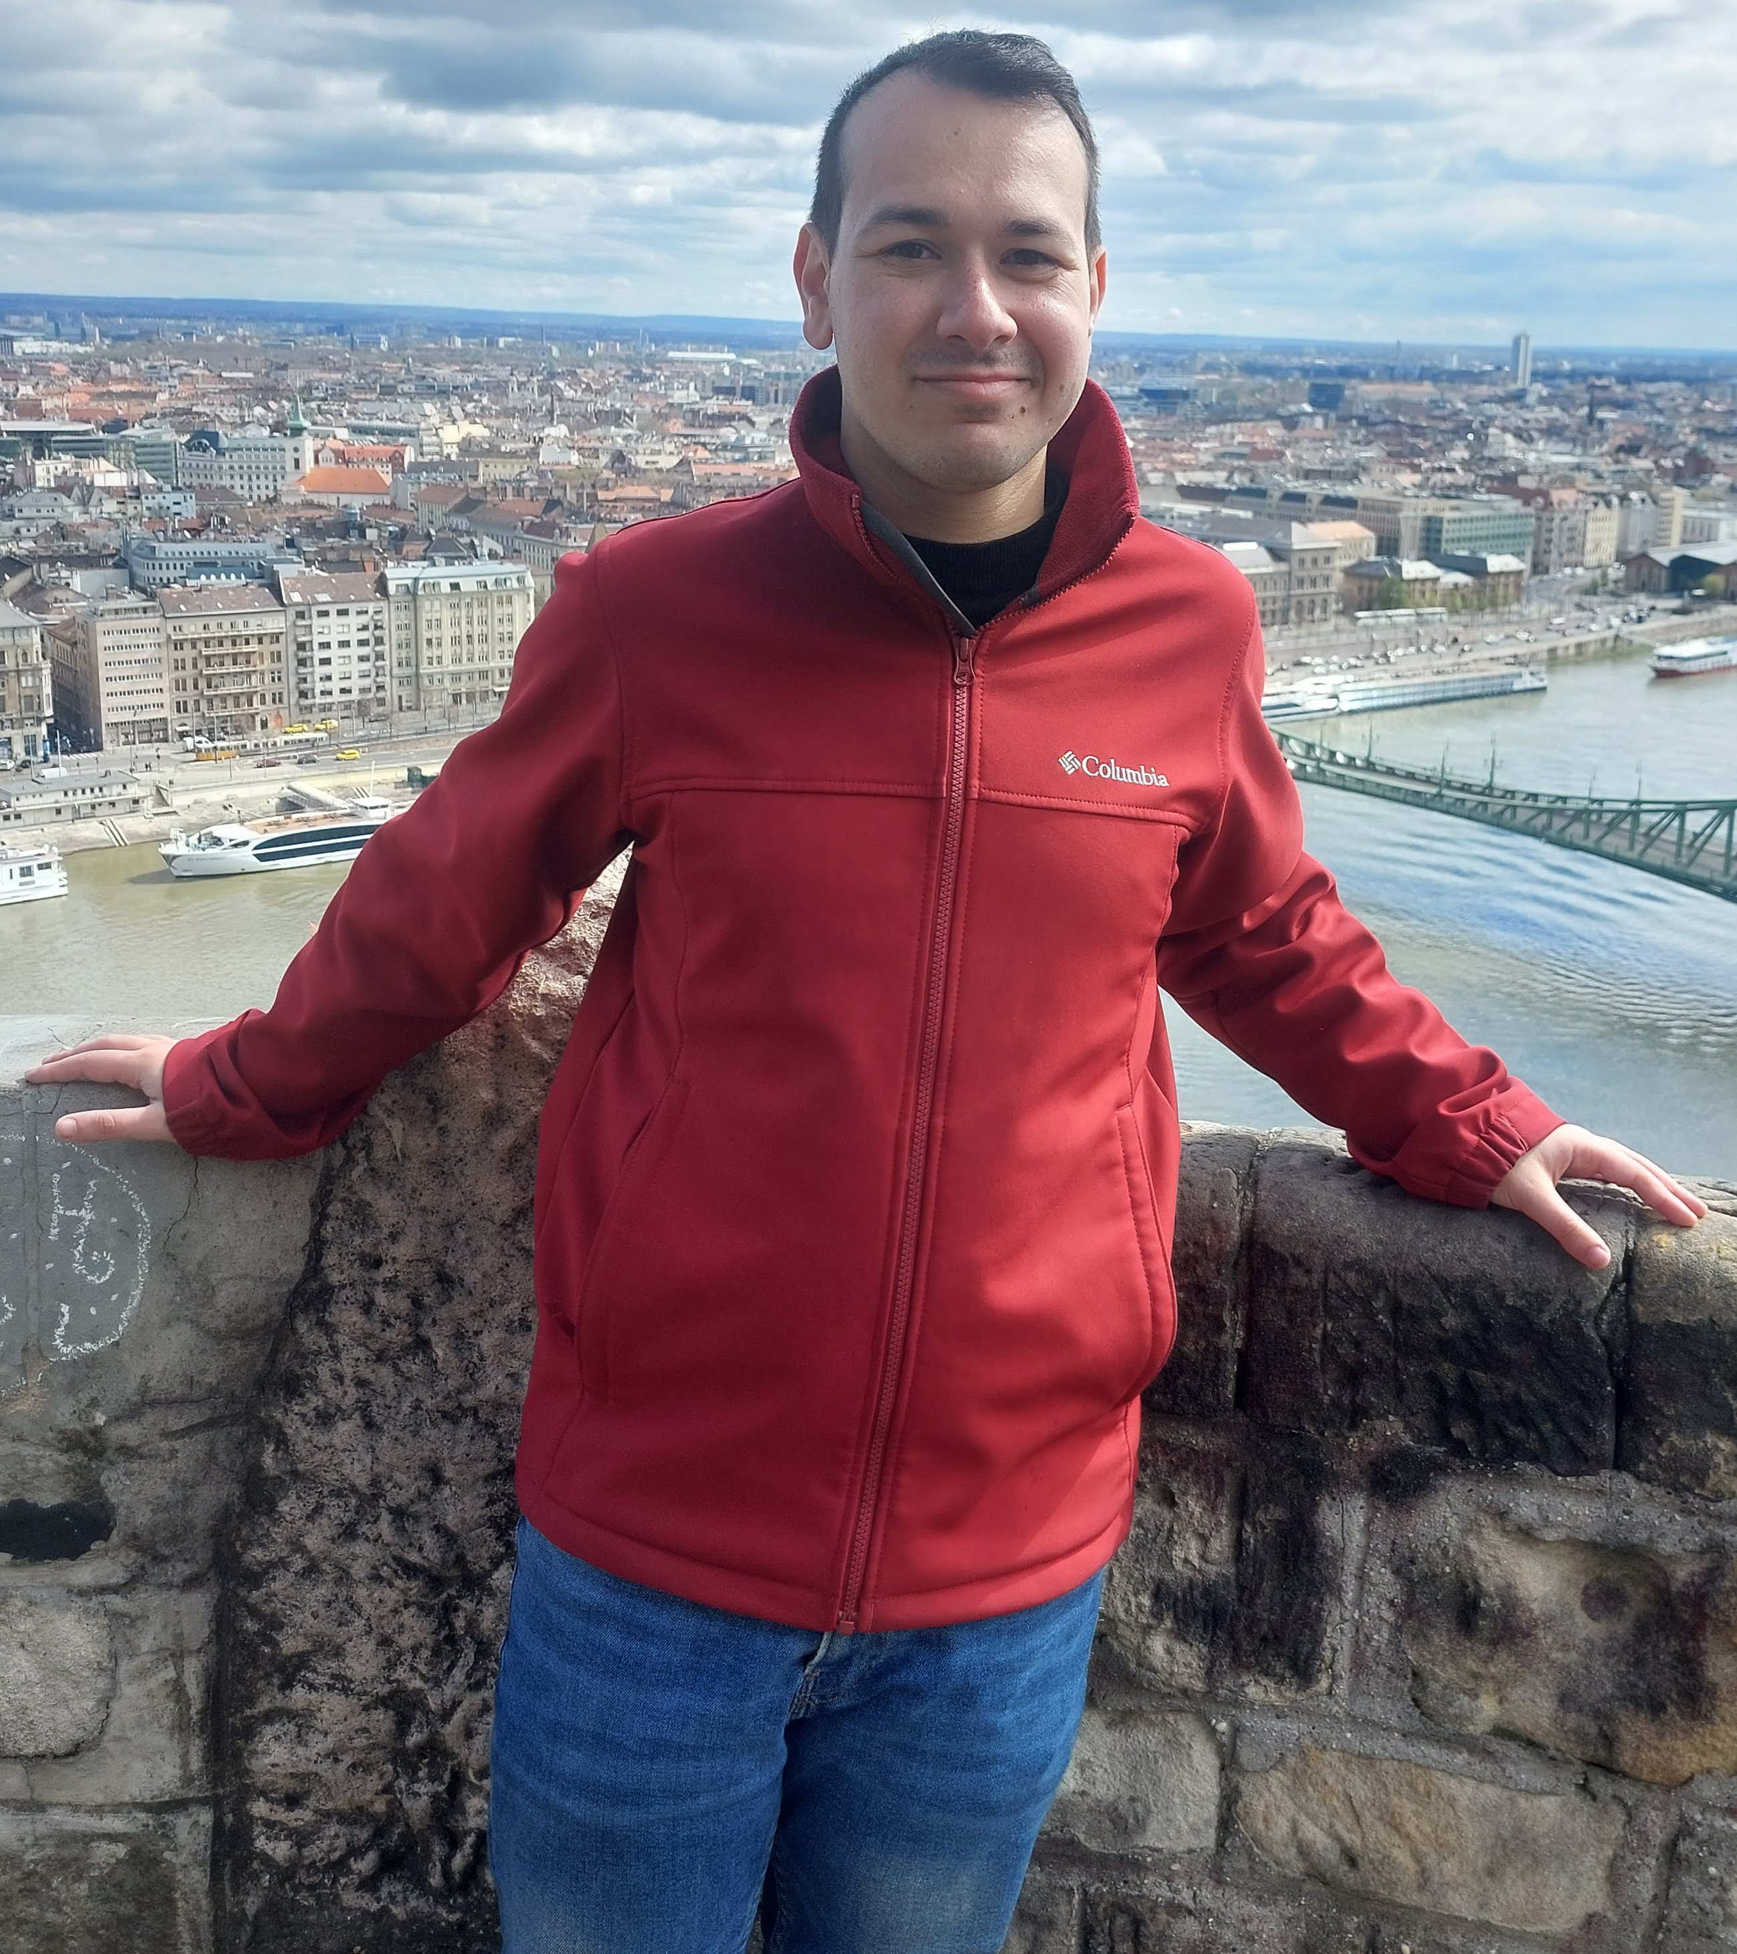

Course: Image Processing 31651 Assignment #41 Noise and Median Filtration
Photo of the student | Shorten Name | ID (4 last digits)
 | shienfeld | 1950 | Student #1
 | pony | 2210 | Student #2
 | akimov | 7939 | Student #3
Photo of the student | Shorten Name | ID (4 last digits)
 | shienfeld | 1950 | Student #1
 | pony | 2210 | Student #2
 | akimov | 7939 | Student #3

Slide 2
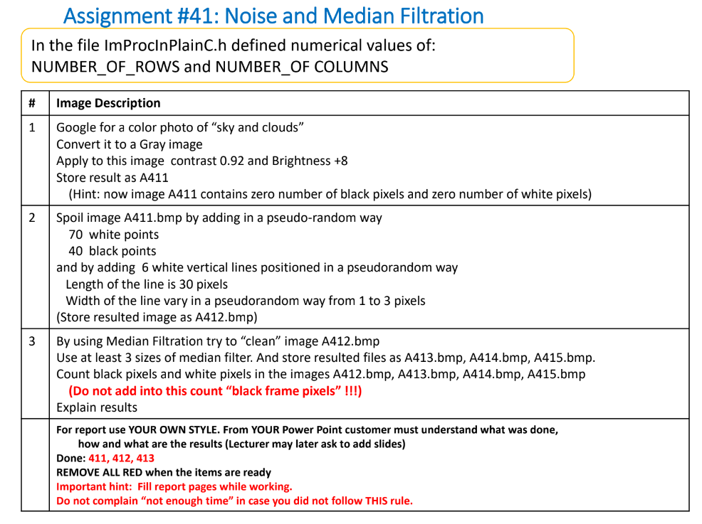

Slide 3
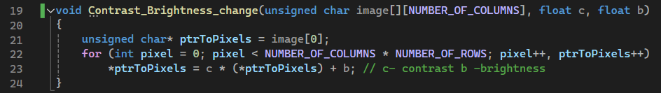
41.1 - first important function –”Contrast_Brightness_change”
obtaining a pointer to the first element of the image array. This pointer (ptrToPixels) will be used to iterate through all the pixels in the image.
for loop that runs through all the pixels in the image for covering every pixel in the 2D image array.
In addition : The pointer ptrToPixels is incremented to point to the next pixel in the image.
Inside the loop, each pixel value is adjusted by applying the contrast and brightness transformation: *ptrToPixels = c * (*ptrToPixels) + b.
note 1: c is a float representing the contrast adjustment factor. A value greater than 1 increases contrast, while a value between 0 and 1 decreases contrast.
note 2 : b is a float representing the brightness adjustment factor. Adding a positive value increases brightness, while adding a negative value decreases brightness.

Slide 4
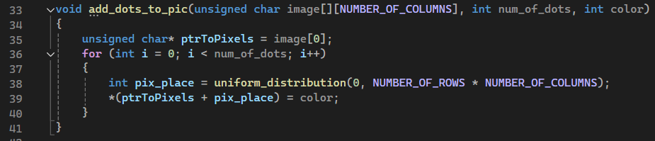
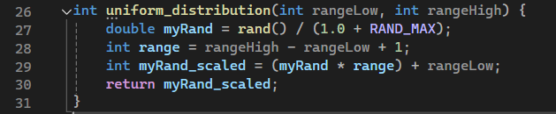
41.2 - second important function –” add_dots_to_pic”
obtaining a pointer to the first element of the image array. This pointer (ptrToPixels) will be used to iterate through all the pixels in the image.
A for loop runs num_of_dots times, adding one dot per iteration.
The function then sets the pixel at the random position to the specified color. It calculates the address of the random pixel by adding pix_place (the random position) to the base pointer (ptrToPixels) and then computes this pointer to set the pixel value.
Inside the loop, the function calls the function uniform_distribution to generate a random position within the bounds of the image. This ensures that the dots are placed at random locations. (see explanation below regarding uniform_distribution function)
The uniform_distribution function generates a random integer within a specified range, which is used to determine the random positions for the dots.
The function ensures that the dots are placed at random locations within the image.
Another important addition – set in the main – will be explained later

Slide 5
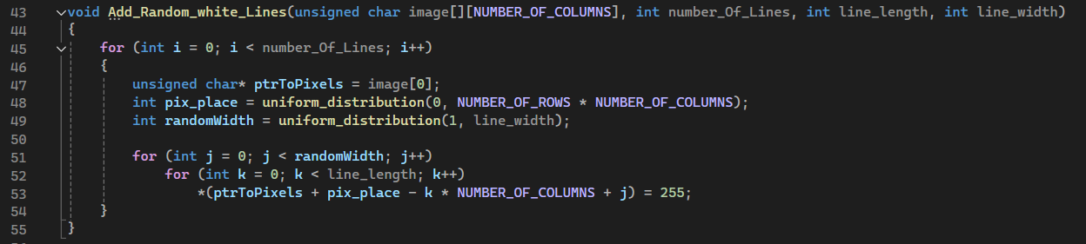
41.3 - third important function –” Add_Random_white_Lines”
A for loop runs number_Of_Lines times, adding one vertical line per iteration.
the function calls uniform_distribution to generate a random position within the bounds of the image. This ensures that the starting position of each line is chosen randomly.
Two nested for loops are used to set the pixel values for the line. The outer loop iterates over the width of the line, and the inner loop iterates over the length of the line.
ptrToPixels + pix_place = moves the pointer to the starting position of the line
- k * NUMBER_OF_COLUMNS = moves the pointer upwards by k rows.
+ j = moves the pointer to the right by j columns.
The function calls uniform_distribution again to determine the width of the line.
This width is a random value between 1 and the specified maximum width (3).
Line 53 is used to (1) Calculate the correct position in the 1D array representation of the 2D image , and (2) Set the pixel at that position to white (255) – it will cause the drawing a vertical line of a specified length and random width at a random position in the image.

Slide 6
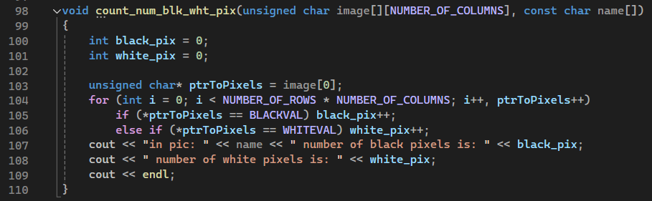
41.4 - fourth important function –” count_num_blk_wht_pix”
These variables will store the counts of black and white pixels.
Inside the loop, the function checks the value of each pixel:
If the pixel value is equal to BLACKVAL (which is defined as 0), it increments the black_pix counter.
If the pixel value is equal to WHITEVAL (which is defined as 255), it increments the white_pix counter.
The pointer ptrToPixels is incremented after each iteration to move to the next pixel.
After the loop, the function prints the counts of black and white pixels using cout.
The printed message includes the name of the image and the counts of black and white pixels.

Slide 7
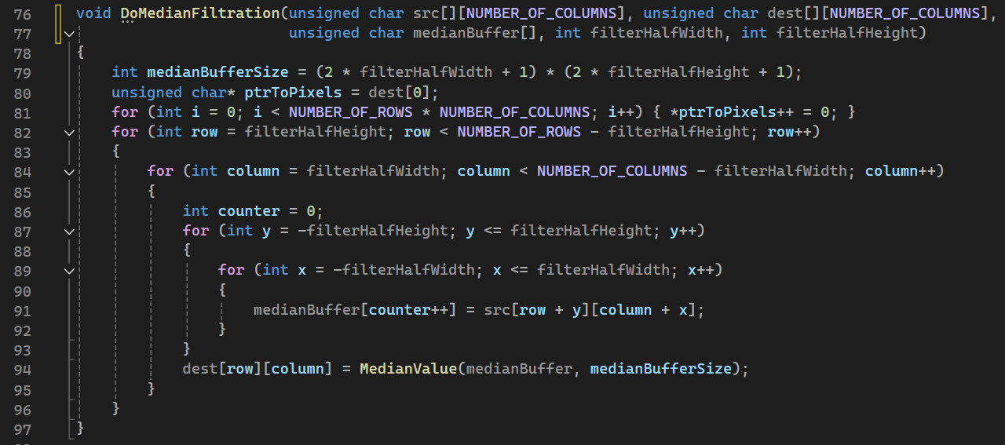
41.5-fifth important function –” DoMedianFiltration” – part 1
Explanation of the function – next slide – because of the major importance and complication of the function we will explain a bit deeper. We will explain the code step by step / part by part .

Slide 8
41.5-fifth important function –” DoMedianFiltration” – part 2
First – we will present the inputs of the function – the filtration process is a bit more complicated so we decided to start by explaining the function step by step
src = This is a 2D array of unsigned char representing the source grayscale image to be filtered.
dst = This is a 2D array of unsigned char where the filtered image will be stored.
The purpose of the function is to apply a median filter to a given image.
Previously we explained about the goal of the filter – but in short : creating a new image where each pixel's value is replaced by the median value of the pixels in a neighborhood around it.
medianBuffer = This is an array used to store the neighborhood pixel values for calculating the median.
filterHalfWidth = This is the half-width of the filter window. The full filter width is 2 * filterHalfWidth + 1.
filterHalfHeight = This is the half-height of the filter window. The full filter height is 2 * filterHalfHeight + 1.

Slide 9
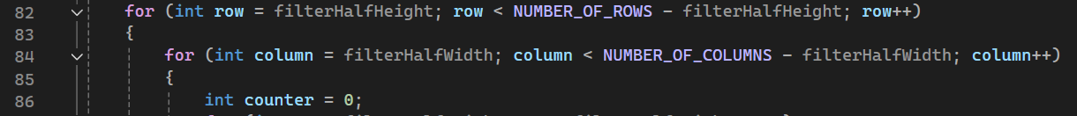
41.5-fifth important function –” DoMedianFiltration” – part 3
The medianBufferSize is calculated as the total number of pixels in the filter window
which is the size of the median buffer
Set all pixels in the destination image to 0. This ensures the destination image is initialized and any pixels not processed by the filter remain zero.
The outer loop iterates over the rows of the image starting from filterHalfHeight to NUMBER_OF_ROWS - filterHalfHeight.
Important to do because it helps us to avoid processing the edges of the image where the filter window would extend outside the image boundaries.
The inner loop iterates over the columns

Slide 10
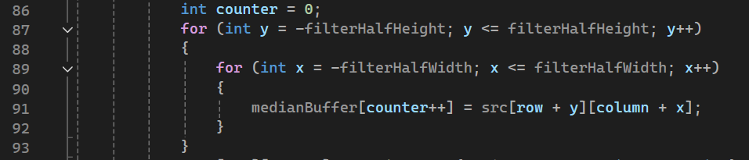
41.5-fifth important function –” DoMedianFiltration” – part 4
Use nested loops to iterate over the neighborhood defined by filterHalfHeight and filterHalfWidth.
Collect pixel values from the source image into medianBuffer. medianBuffer[counter++] stores the pixel value at position (row + y, column + x) from the source image.
Call new function - MedianValue - to compute the median of the pixel values stored in medianBuffer.
Then - Assign the computed median value to the corresponding pixel (row, column) in the destination image.
Next , we will explain about the MedianValue assistance function

Slide 11
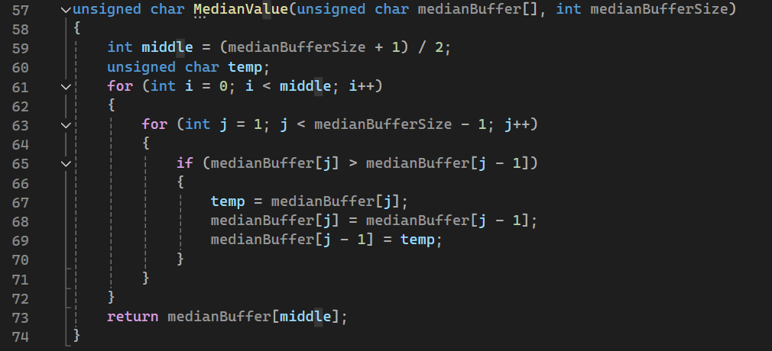
41.6-sixth important function –” MedianValue”
The MedianValue function computes the median of an array of pixel values.
Calculate the middle index of the buffer.
Sort the buffer partially until the middle index. This is a simplified sorting algorithm that ensures the median value is in the correct position.
The function returns the value at the middle index of the partially sorted buffer as the median.

Slide 12
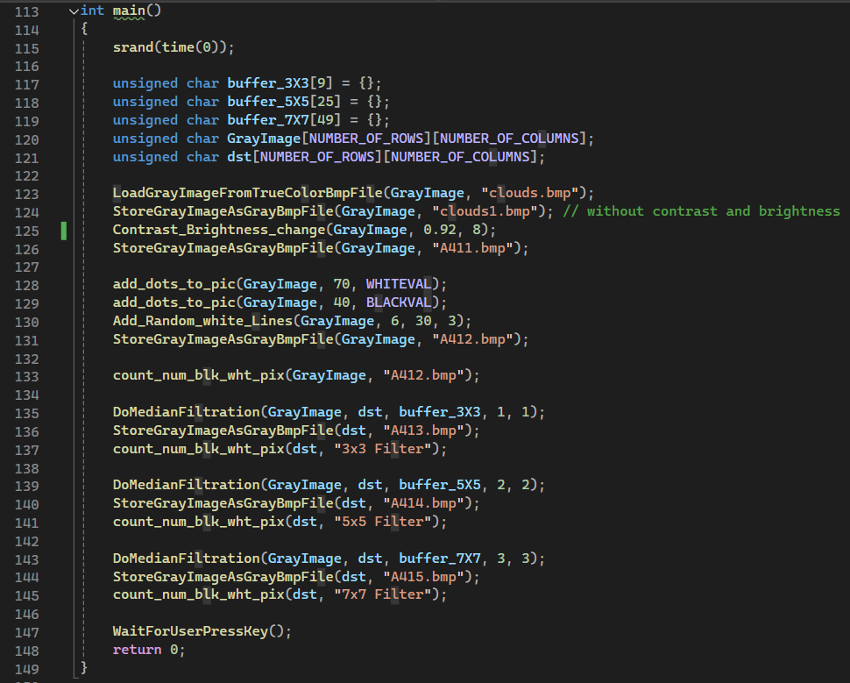
41.7-ninth important function – ”main”
These arrays are initialized to hold pixel values for the images and the median filter buffers:
buffer_3X3, buffer_5X5, and buffer_7X7 are used to store pixel values for median filtering with different filter sizes , GrayImage stores the grayscale image , dst stores the resulting image after applying median filtering.
srand(time(0)) initializes the random number generator with the current time. This ensures that the sequence of random numbers generated in the program will be different each time it runs.

Slide 13

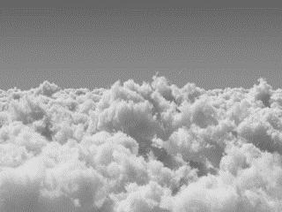

41.8-presentation and profilers of the created images by the program – part 1
Clouds.bmp
Clouds1.bmp
A411.bmp

Slide 14
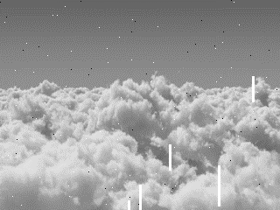
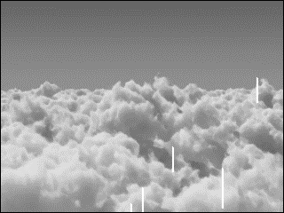
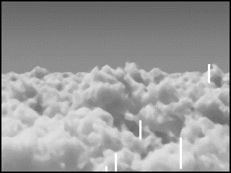
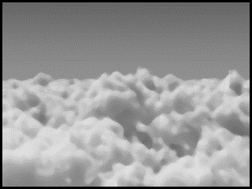
41.8-presentation and profilers of the created images by the program – part 2
A411.bmp
A412.bmp
A413.bmp
A414.bmp
A415.bmp

Slide 15
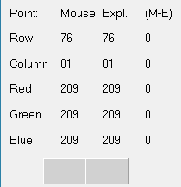
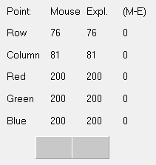
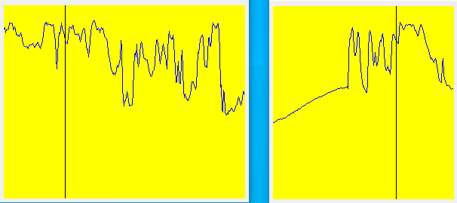
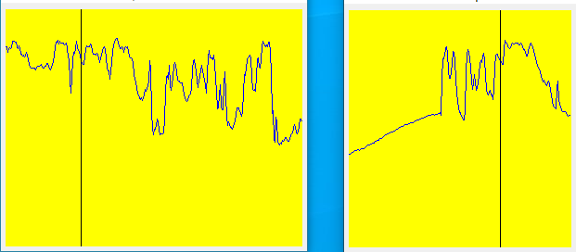
41.8-presentation and profilers of the created images by the program – part 3
Clouds1.bmp
A411.bmp
Clouds1.bmp is the grayscale version of the original clouds.bmp color image
A411.bmp is an improved version of clouds1.bmp – improvement in contrast and brightness – in the point explorer one can see improvement from 209 to 200.

Slide 16
41.8-presentation and profilers of the created images by the program – part 4
A412.bmp
We have added 6 white vertical lines positioned in random locations , the length of the lines is 30 pixels and the width is between 1 to 3 pixels randomly.
The amount of white pixels we have: 70
The amount of black pixels we have: 40

Slide 17
41.8-presentation and profilers of the created images by the program – part 5

Slide 18
41.8-presentation and profilers of the created images by the program – part 6

